Slide 1
HOUSE PRICE PREDICTION
A. VINEELANJALI(22N31A0511)
D. ROHITH SAI(22N31A0545)
B. PAVAN ADITYA(22N31A0529)

Slide 2

Malla Reddy College of Engineering & Technology
(Autonomous Institution- UGC, Govt. of India)
(Affiliated to JNTUH, Hyderabad,
Internal Guide
Ms.P.L.Shailaja
Assistant Professor
Department of Computer Science and Engineering
Project Team Members
A. VINEELANJALI 22N31A0511
D. ROHITH SAI 22N31A0545
B. PAVAN ADITYA 22N31A0529

Slide 3
ABSTRACT
In today’s world many people have a doubt about the prices of their dream house which usually results in them buying the house for highly inflated prices and overpaying due to the commissions taken by the brokers. Our project Wise Price Vision aims to reduce this problem and give an application which is going to predict the correct prices and save innocent people from these scams. The project Wise Price Vision uses the Machine Learning concept where the users give the square feet, BHK and number of bathrooms as input and based on the location of the apartment it predicts the price of the apartment.

Slide 4
OBJECTIVE AND SCOPE OF THE PROJECT :
The objective of house price prediction is to forecast the market value of residential properties accurately.
Accurate price predictions aid in making informed decisions regarding property transactions and ensuring fair deals.
The scope of house price prediction extends across various domains within the real estate industry, finance, urban planning, and policymaking.
At its core, it involves the development and application of predictive models to estimate the market value of residential properties.

Slide 5
Existing System:
Data Collection: Gathers data from multiple sources like property listings, sales history, economic indicators, and demographics.
Data Preprocessing: Cleans, normalizes, and engineers features to make the data usable for prediction models.
Feature Extraction: Identifies key factors such as location, size, and amenities affecting house prices.
Price Prediction: Uses models to estimate house prices based on processed data.
Limitations: Lacks user interaction and may not provide real-time or highly accurate predictions..

Slide 6
Proposed System:
User-Friendly Interface: Develops an intuitive interface for users to input property details like size, BHK, and number of bathrooms.
Real-Time Data Input: Allows users to input real-time property features, such as location, square footage, and amenities.
Accurate Price Prediction: Utilizes advanced machine learning models to predict house prices based on current data and location-specific factors.
Visualization and Insights: Provides users with detailed price predictions, relevant insights, and visualizations for better decision-making.
Improved Interaction: Enhances user experience by delivering real-time, personalized, and interactive feedback.

Slide 7
LITERATURE REVIEW :-
AUTHOR | METHOD USED
Anand G. Rawool , Dattatray V. Rogye , Sainath G. Rane , Dr. Vinayk A | House Price Prediction Using Machine Learning, 2021.
Chenhao Zhou | House price prediction using polynomial regression with Particle Swarm Optimization, 2021.
Anirudh Kaushal, Achyut Shankar | House Price Prediction Using Machine Learning, 2021

Slide 8
LITERATURE REVIEW :-
AUTHOR | METHOD USED
Felipe Alonso Arias Arbelaez and Francisco Ivan Zuluaga Daz | Estimation of Real Estate Asset Pricing Models, 2016. 10. A
Abdul G. Sarip and Muhammad Burhan Hafez | Fuzzy Logic Application for House Price Prediction, 2015.
Ankita Kamire , Nitin Chaphalkar , Sayali Sandbhor | Real Property Value Prediction Capability Using Fuzzy Logic and ANFIS, 2021.

Slide 9
REQUIREMENTS SPECIFICATIONS
HARDWARE REQUIREMENTS:
1. Processor: Intel Core i5 or above for high-speed processing.
2. RAM: 8 GB or more for smooth multitasking and handling large datasets.
3. Hard Drive: 1 TB SSD for fast data access and ample storage.
4. Graphics Card: Dedicated GPU with at least 4 GB VRAM for enhanced data visualizations.
5. Display Resolution: 1920x1080 (Full HD) or higher for crystal-clear visuals.
6. Screen Size: 15.6 inches or larger for an optimal interface experience.
7. Network Adapter: High-speed Ethernet/Wi-Fi adapter for seamless connectivity.
8. USB Ports: At least 4 USB 3.0 ports for peripheral device integration.

Slide 10
REQUIREMENTS SPECIFICATIONS
SOFTWARE REQUIREMENTS:
1. Operating System: Windows 10/11 (64-bit) or Linux (Ubuntu 20.04+) for better compatibility and performance.
2. Programming Language: Python 3.8 or above for machine learning model development.
3. IDE: PyCharm or Visual Studio Code for efficient code writing and debugging.
4. Web Framework: Flask or Django for building a robust web-based user interface.
5. Front-End Technologies: HTML5, CSS3, JavaScript, and Bootstrap for a responsive design.
6. Machine Learning Libraries: Scikit-learn, TensorFlow, or PyTorch for predictive modeling.
7. Database: MySQL or PostgreSQL for efficient data management.
8. Data Visualization: Matplotlib and Seaborn for generating insights and visual reports.

Slide 11
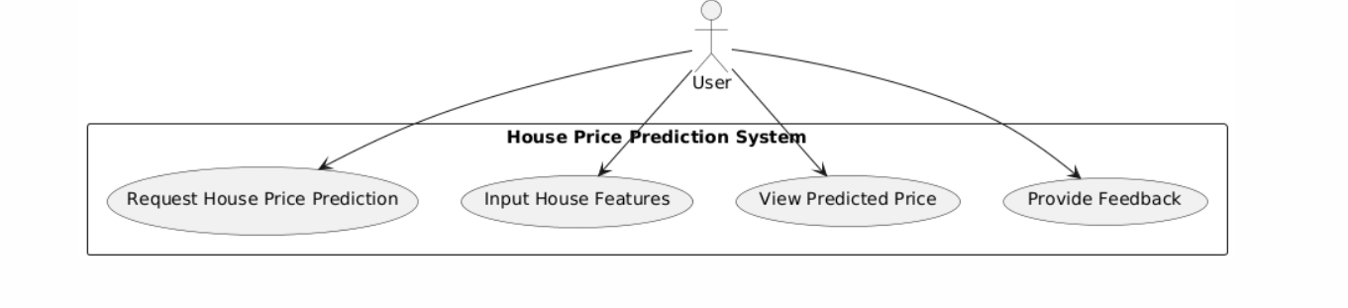
UML DIAGRAMS:- 1)Usecase diagram

Slide 12
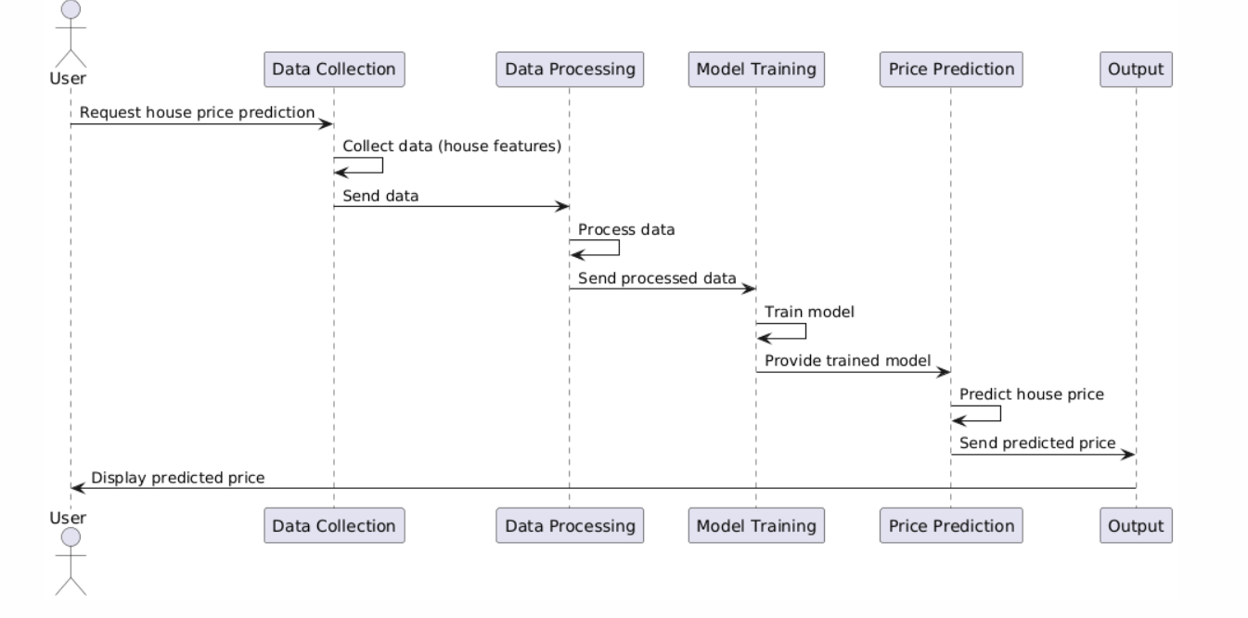
2)Sequence diagram

Slide 13
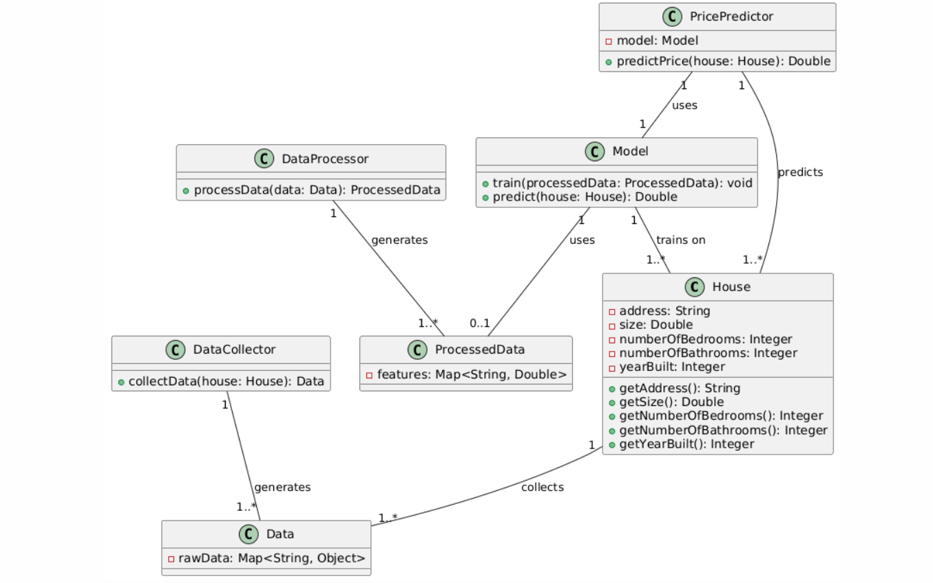
3)Class diagram

Slide 14
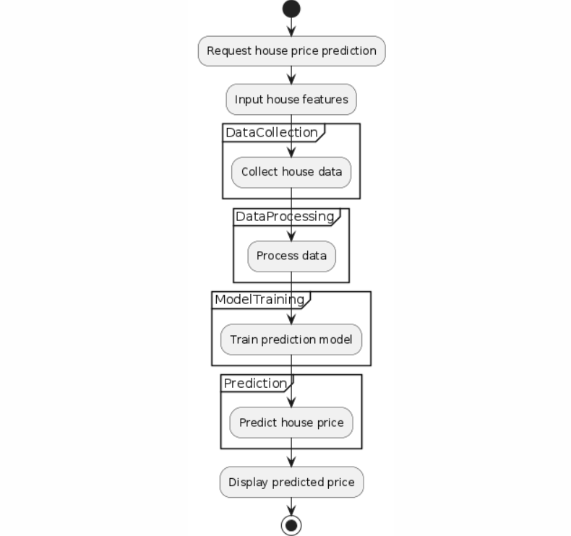
4)Activity diagram

Slide 15
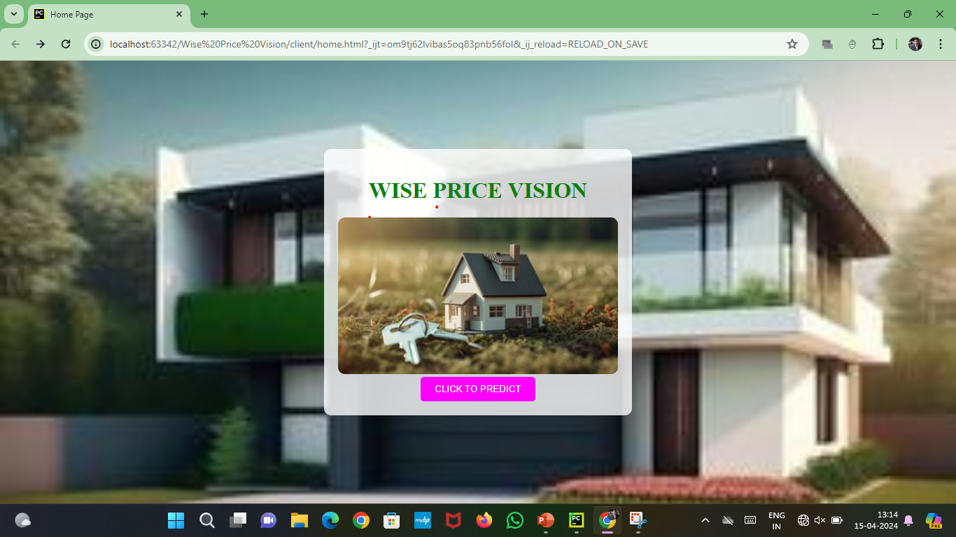

Slide 16
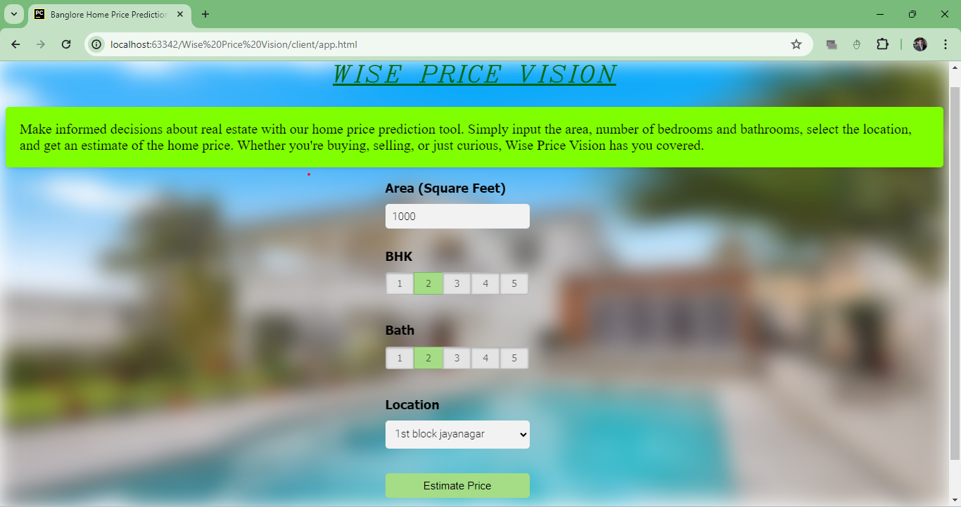

Slide 17
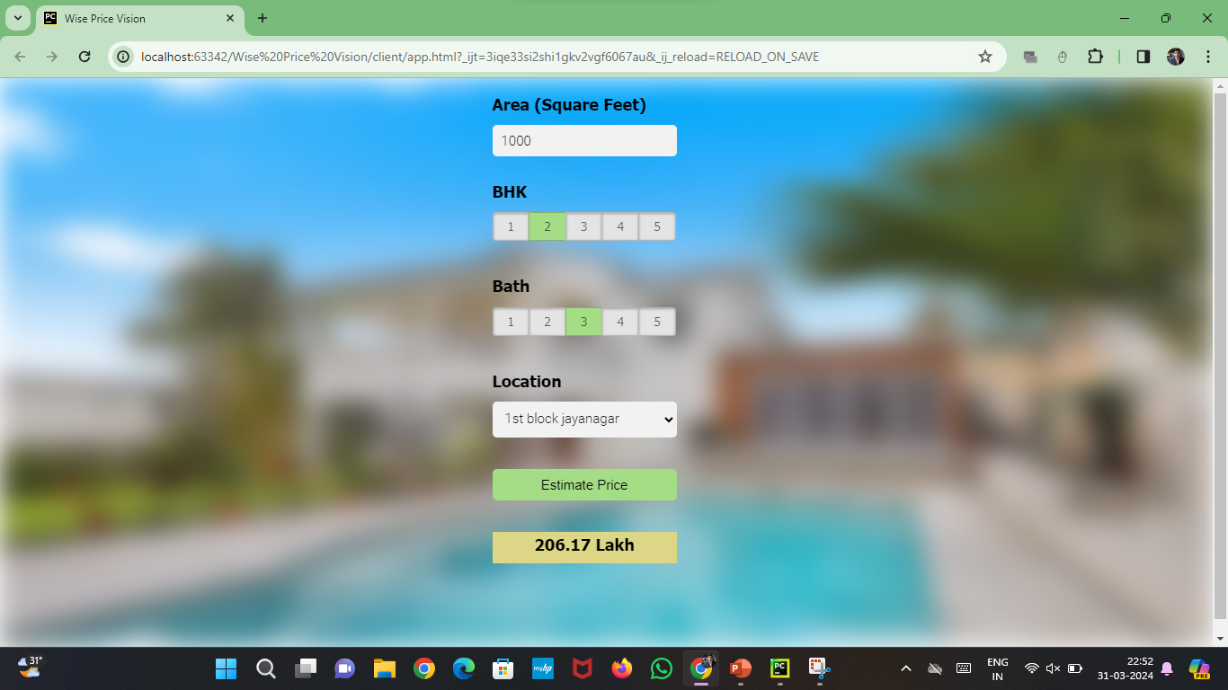

Slide 18
THANK YOU…….

